Slide 1
Food Street
Database
NAME : RANBIR CHAUHAN
ROLL NO : 22MEB0B20
BRANCH : MECHANICAL
YEAR : 4TH

Slide 2
WHY I CHOOSE THIS PROJECT?
There is a place called food street in our college where many food items including fast food are sold. Many Students usually buy food every day here. There are nearly 10 stalls on Food Street. Each stall is famous for particular items.
Students usually wait hours to get their food ready after giving an order. In this way, much time is wasted and students are losing interest in buying food from the food street and going outside to buy it.
So, I got an idea why can’t we propose an online food order system in our college? So that students can order from their rooms or any place in the college and get their food to their place.
Provided that some delivery charges will be charged for the order.
To do this, I first have to study how online food delivery platforms like Zomato, Swiggy works. Based on that I can design a database for our college food street.

Slide 3
REQUIREMENT ANALYSIS
The online food ordering system sets up a food menu online and students can easily place the order as per their wish.
Also with a food menu, students can easily track their orders.
The payment can be made online or pay-on-delivery system.
For more secure ordering separate accounts are maintained for each user by providing them with an ID and a password

Slide 4
FINDING AND ORGANIZING THE REQUIRED INFORMATION
I have divided the information into 6 categories.
Student info
Hostel info
Stalls and Menu info
Order and Status info
Payment info
Delivery boy info

Slide 5
DIVIDING THE INFORMATION INTO TABLES
student
roll no
room no
credentials
e-mail
ph
hostel
hostel id
name
stall
stall id
name
min order
ph
timings
items
name
type
section
available
cost
payment mode
name
type
orders
order number
order date
description
delivery charge
delivery boy
delivery boy id
name
ph
order status
timestamp
status

Slide 6
SPECIFYING THE PRIMARY KEYS
ENTITY | PRIMARY KEY
student | roll_no
stall | stall_id
item | item_name
order | order_number
payment_mode | name
hostel | hostel_id
delivery_boy | delivery_boy_id

Slide 7
TABLE RELATIONSHIPS
Student
A student can place many orders while an order is placed by only one student. Hence it is a 1:N relationship
A student can have more than one payment method and many students can have the same payment method. Hence it is an M: N relationship
A student can be present in only one hostel but a hostel can have many students. Hence it is an N:1 relationship
Stall
A Stall can have many items and the same item may be in many Stalls. Hence it is M: N relationship
An order can be placed only from one Stall but a Stall can have many orders. Hence it is an N:1 relationship

Slide 8
TABLE RELATIONSHIPS
Orders
A order may have many items and the same item can be involved in many orders. Hence it is a M: N relationship.
An order can be paid by only one payment method while a payment method can be used to pay many orders. Hence there is a N:1 relationship.
A delivery boy can deliver many orders while an order can be delivered by only one delivery boy. Hence it is a N:1 relationship.
When an order is placed it has stages i.e. at what time is it placed, at what time the order is accepted/rejected by the Stall, at what time the order is picked up by the delivery boy and at what time is it delivered. Hence it is in a 1:N relationship

Slide 9
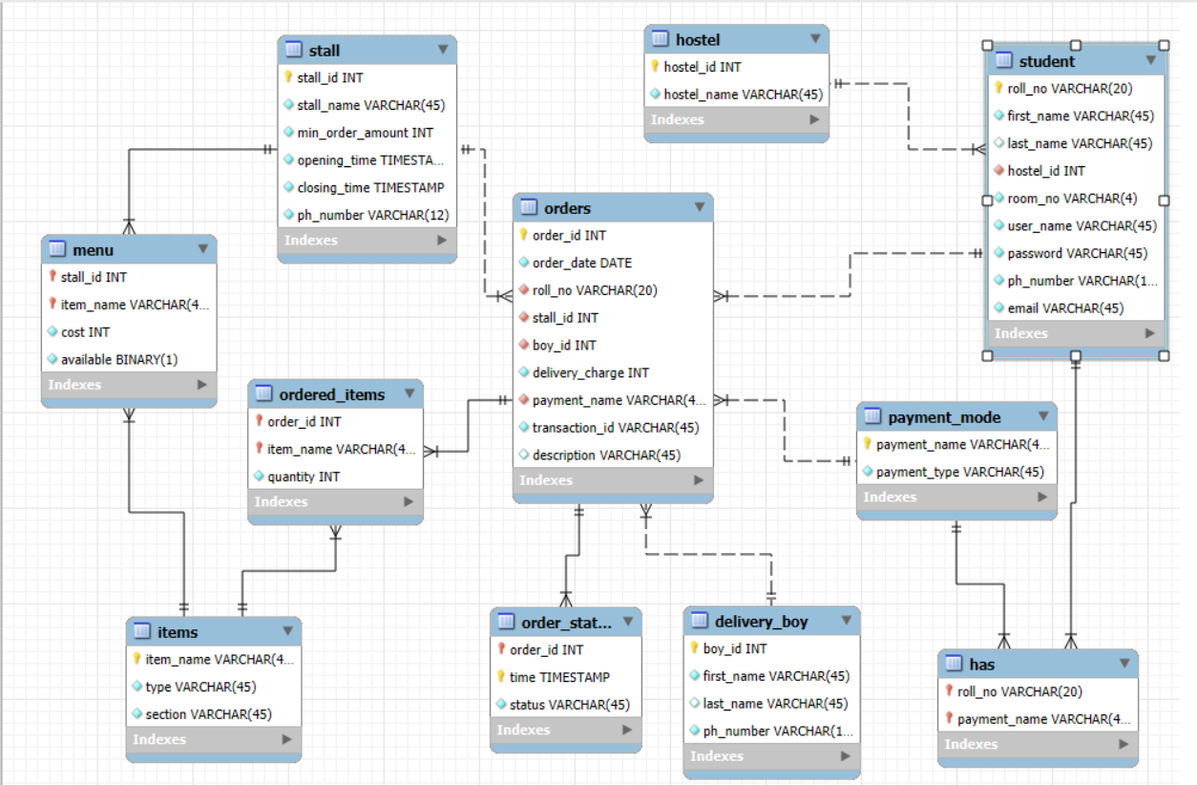




RELATIONAL MODEL

Slide 10
APPLYING NORMALIZATION RULES
STUDENT :
(roll_no) → (first_name,last_name,hostel_id,room_no,username, email_id, password, ph_number)
(email_id) → (first_name,last_name,hostel_id,room_no,roll_no,username, password, ph_number)
(ph_number) → (first_name,last_name,roll_no,hostel_id,room_no,username, email_id, password)
Candidate keys are roll_no, ph_number, email_id
Primary key is roll_no
All the non-prime attributes completely depend on candidate keys. Hence the relation is in 2NF.
All the non-prime attributes are not transitively dependent on any key of the table. Hence the relation is in 3NF.
HOSTEL :
(hostel_id) → (hostel_name)
Primary key hostel_id
All the non-prime attributes completely depend on candidate keys. Hence the relation is in 2NF.
All the non-prime attributes are not transitively dependent on any key of the table. Hence the relation is in 3NF.

Slide 11
APPLYING NORMALIZATION RULES
Stall:
(stall_id) → (name, min_order, ph_number, opening_time, closing_time)
(ph_number) → (name, min_order, stall_id, opening_time, closing_time)
Candidate keys are stall_id , ph_number
Primary key is stall_id
All the non-prime attributes completely depend on candidate keys. Hence the relation is in 2NF.
All the non-prime attributes are not transitively dependent on any key of the table. Hence the relation is in 3NF.
ITEMS :
(item_name) → (type, section)
Primary key is item_name
All the non-prime attributes completely depend on candidate keys. Hence the relation is in 2NF.
All the non-prime attributes are not transitively dependent on any key of the table. Hence the relation is in 3NF.

Slide 12
APPLYING NORMALIZATION RULES
MENU :
(stall_id, item_name) → (cost, available)
Primary key is (stall_id, item_name)
All the non-prime attributes completely depend on candidate keys .Hence the relation is in 2NF.
All the non-prime attributes are not transitively dependent on any key of the table. Hence the relation is in 3NF.
PAYMENT MODE :
(payment_name) → (payment_type)
Primary key is payment_name
All the non-prime attributes completely depend on candidate keys .Hence the relation is in 2NF.
All the non-prime attributes are not transitively dependent on any key of the table. Hence the relation is in 3NF.

Slide 13
APPLYING NORMALIZATION RULES
HAS :
(roll_no,payment_name) → (roll_no, payment_name)
Since there are no non-prime attributes, table is in 3NF.
DELIVERY_BOY :
(boy_id) → (first_name, last_name, ph_number)
(ph_number) → (first_name, last_name, boy_id)
Candidate key are boy_id, ph_number
Primary key is boy_id.
All the non-prime attributes completely depend on candidate keys. Hence the relation is in 2NF.
All the non-prime attributes are not transitively dependent on any key of the table. Hence the relation is in 3NF.

Slide 14
APPLYING NORMALIZATION RULES
ORDERS :
(order_number) → ( order_date, stall_id, roll_no, boy_id, delivery_charge , payment_name, transaction_id, description)
Primary key is order_number
All the non-prime attributes completely depend on candidate keys .Hence the relation is in 2NF.
All the non-prime attributes are not transitively dependent on any key of the table. Hence the relation is in 3NF.
ORDERED_ITEMS :
(order_number, item_name) → (quantity)
Primary key is (order_number, item_name)
All the non-prime attributes completely depend on candidate keys. Hence the relation is in 2NF.
All the non-prime attributes are not transitively dependent on any key of the table. Hence the relation is in 3NF.

Slide 15
APPLYING NORMALIZATION RULES
ORDER_STATUS :
(order_number, timestamp) → (status)
Primary key is (order_number, timestamp)
Since there are no non-prime attributes, the table will be in 3NF

Slide 16
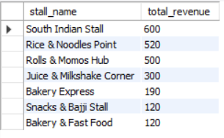
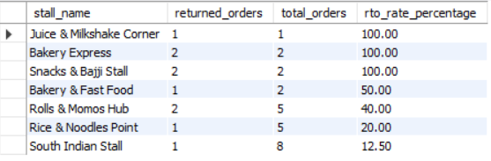
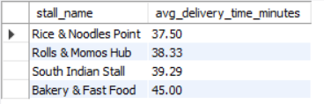
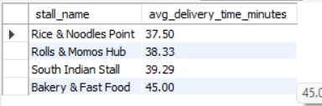
KPI Queries Result
Stallwise Revenue
RTO Rate
Average Delivery Time
Top 5 Fastest Stalls

Slide 17
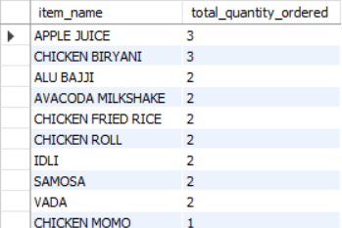
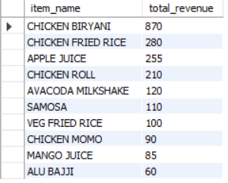
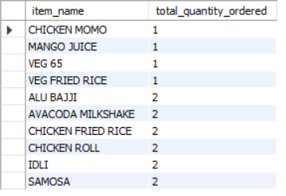
Most Frequently Ordered Items
Top Revenue Generating Items
PROJECT LINK
Least Ordered Items

